Slide 1
Module 5 – DevOps with Containers

Slide 3
Agenda
Container Devops Value Proposition
What is DevOps?
Azure DevOps overview ​
Containerized Workflow Pipeline ​
Azure DevOps: Continuous Integration ​- Windows/Linux
Azure DevOps : Continuous Deployment - SF/AKS​

Slide 4
Software Innovation Collision
Containers
Standardization of the application packaging
DevOps
Optimizing how applications are built, delivered and managed
Microservices
Optimizing how applications are composed
Better Software
Cloud Orchestrators
Efficient ways to deliver Infrastructure for Applications
Notes:
We’ve talked about what containers are and how we can work with them, then we’ve talked about how containers are great for deploying microservices. Once we are deploying a variety of microservices, we look to an orchestrator to help us schedule and manage our services. Now we will talk about DevOps. When combining these technologies and approaches, we can enable the development and deployment of better software

Slide 5
Devops View Of The Container Advantage
Fast iteration
Agile delivery
Immutability
Cost savings
Efficient deployment
Elastic bursting
For developers
For IT

Slide 6


High Performance Devops Companies Achieve…
46x Deployment
Frequency
2,555x Faster Lead
Time For Changes
Faster
Time to Market
DevOps
$
Increased
Revenue
7x Lower Change
Failure Rate
2,604x Faster Mean
Time to Recover
Source: 2018 Accelerate: State of DevOps: Strategies for a New Economy." N. Forsgren, J. Humble, G. Kim. DevOps Research and Assessment (DORA)
Notes:
http://stories.visualstudio.com/devops
The link shows Microsoft’s journey towards DevOps => it explain how we made this cultural shift
➔ Optionally: Open the web page
On the web page search for Shift in Role. => small cross functional teams

Slide 7
What is DevOps?
Build& Test
Deploy
DevOps is the union of people, process, and products to enable continuous delivery of value to your end users.
“
Continuous Delivery
Develop
Operate
”
Plan & Track
Monitor & Learn
Notes:
Donovan Brown definition: “DevOps is the union of people, process, and products to enable continuous delivery of value to our end users.”
A bit of marketing discussion but devOps is important to be able to produce more business value
Better collaboration between Developers and IT professionals (Ops)
Example: Don’t reach out to Ops 2 days before a certificate expiration => plan the work ahead of time
Leads to
lower time to market with more frequent deployments
Better software quality
Happier customer => more customers engagement and retention
So it increase overall business value.
One of the key: automation through CI/CD pipeline.

Slide 8
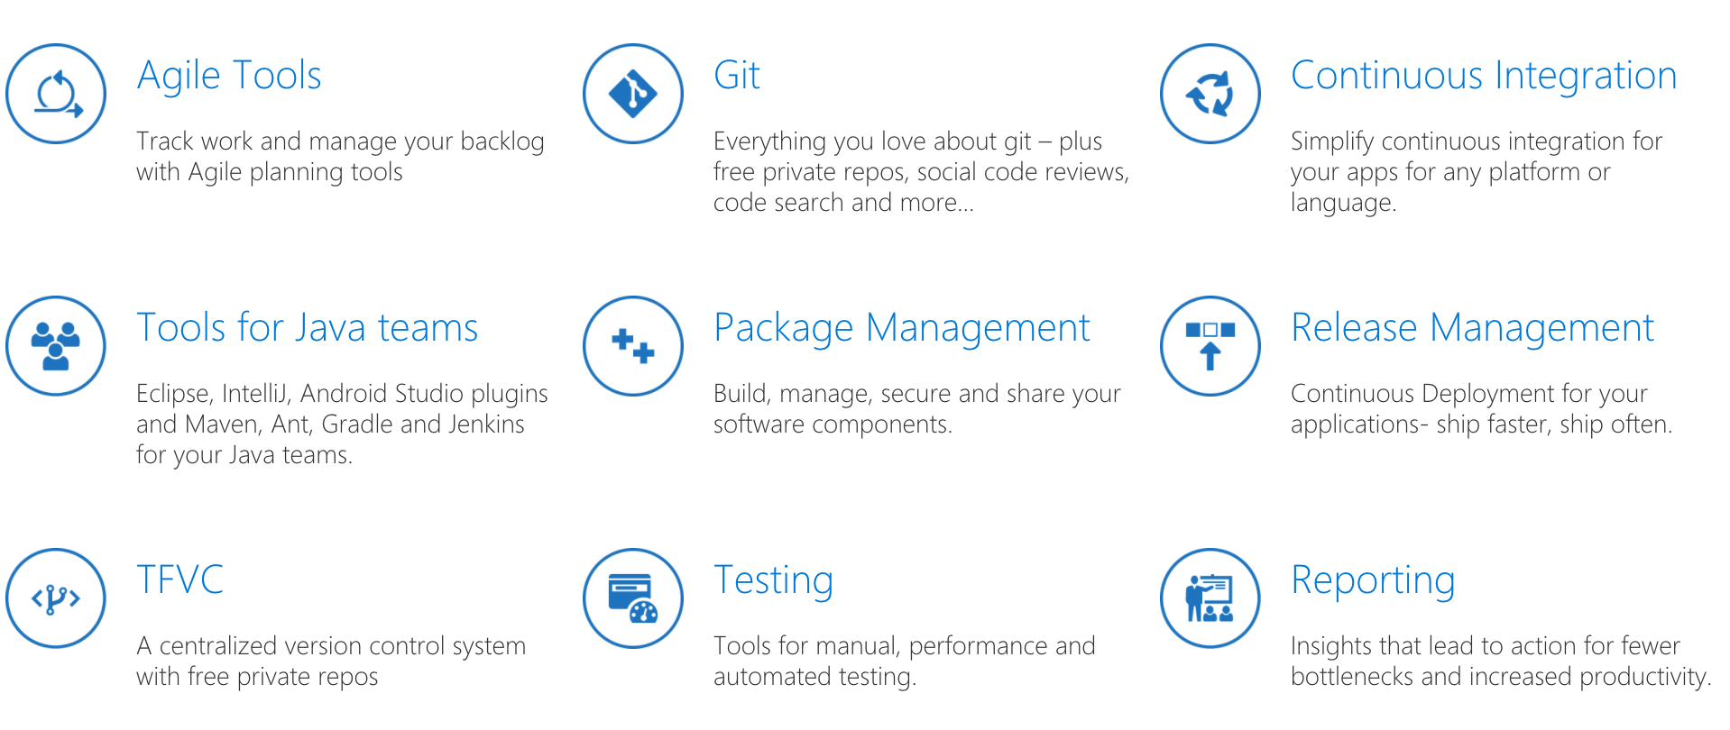
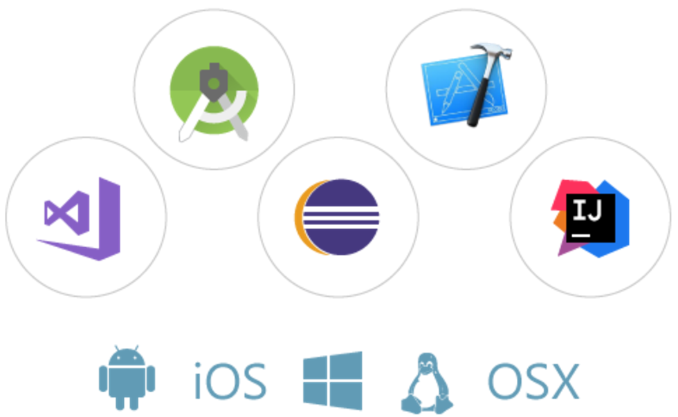
Azure DevOps
Code in any IDE/language and build applications for any target platform.
Increase productivity with powerful features
Notes:
Quick overview of Azure DevOps tooling
Ask the customer at this point, are you using Azure DevOps? If not, what do you use?
Benefit of Azure DevOps is it’s ability to orchestrate all of these DevOps components into one place!

Slide 9





Azure DevOps
Azure Boards
Azure Pipelines
Azure Repos
Deliver value to your users faster using proven agile tools to plan, track, and discuss work across your teams.
Build, test, and deploy with CI/CD that works with any language, platform, and cloud. Connect to GitHub or any other Git provider and deploy continuously.
Get unlimited, cloud-hosted private Git repos and collaborate to build better code with pull requests and advanced file management.
Azure Test Plans
Azure Artifacts
➔
Test and ship with confidence using manual and exploratory testing tools.
Create, host, and share packages with your team, and add artifacts to your CI/CD pipelines with a single click.
https://azure.com/devops
Notes:
So does TFS

Slide 10



DevOps on Azure framework
Plan & Track
Develop
Build & Test
Deploy
Operate
Monitor & Learn
Boards
(Azure DevOps)
GitHub
Repos
(Azure DevOps)
Pipelines & Test Plans
(Azure DevOps)
Artifacts & Pipelines
(Azure DevOps)
Policy
Application
Insights
Trello
GitHub
Jenkins
Terraform
Ansible
ELK Stack
Notes:
Using other technology? That’s fine! Azure DevOps is a great integrator. Integrate the components that you already have and leverage those that you don’t

Slide 11
What Technologies Do I Need To Support Devops?
Continuous Integration (CI)
Improve software development quality and speed.
When you use Azure Pipelines or Jenkins to build apps in the cloud and deploy to Azure, each time you commit code, it’s automatically built and tested and bugs are detected faster.
Continuous Deployment (CD)
By combining continuous integration and infrastructure as code (IaC), you’ll achieve identical deployments and the confidence to deploy to production at any time.
With continuous deployment, you can automate the entire process from code commit to production if your CI/CD tests are successful.
Continuous Learning & Monitoring
With Azure Application Insights you can identify how your applications are performing and test if the recent deployment made things better or worse.
Using CI/CD practices, paired with monitoring tools, you’ll be able to safely deliver features to your customers as soon as they’re ready.
Notes:
DevOps brings together people, processes, and technology, automating software delivery to provide continuous value to your users. Using Azure DevOps, you can deliver software faster and more reliably - no matter how big your IT department or what tools you’re using.

Slide 12


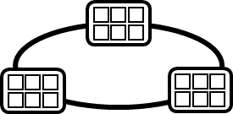

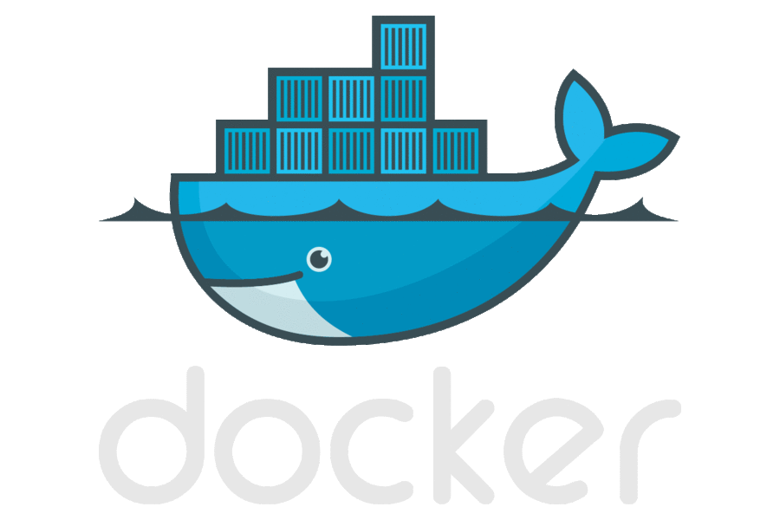


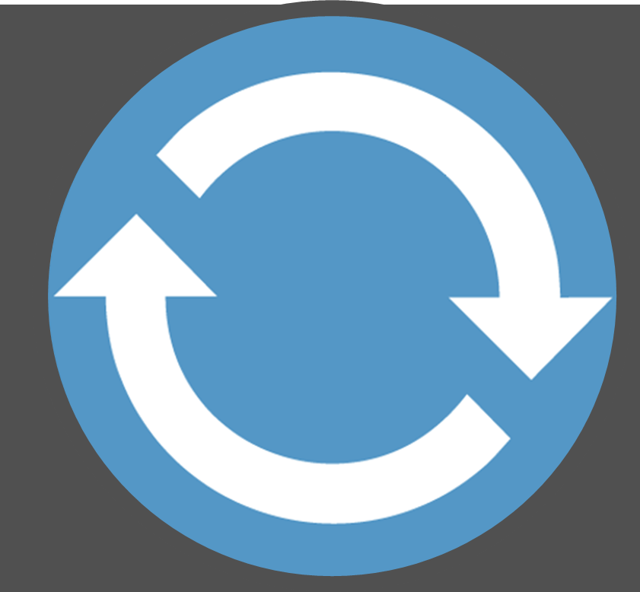
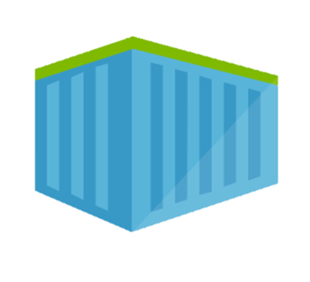
Containerized Workflow Pipeline
…
Azure DevOps
Azure Kubernetes Service
…
Run, Manage
Service Fabric
Source Code Control
(SCC)
Build/CI,
Integrate,
Test
CD, Deploy
…
App Services
Production
environments
…
Future Services
Azure
…
Container Registry
…
Push
Code
…
…
Run
Code
Validate
Debug
Notes:
Here is an example of CI/CD pipeline for containerized application.
From the Dev box => build/run/test container
Push code to Source Control tool (Git) => at bottom left corner
Repository lives in a Visual Studio Team Services (or Jenkins) environment
Your Push triggers a build which will:
Build the container
Push it to Registry
Pull the container
Test the container
After every successful build
Automatic deployment to Pre Prod environment: ACS, Service Fabric, …
Pull container from registry
Run Acceptation test
Every morning (scheduled)
Automatic deployment into Prod
Pull container from registry
Run Acceptation test
Manual validation => From Dev box -> monitoring through App insights or OMS (Operation Management suite) => last lab
OMS ⬄ System Center for the Cloud (same team working on it.)

Slide 13
Containerized Workflow Pipeline With AKS/SF
…
Azure DevOps
Azure Kubernetes Service
…
Run, Manage
Service Fabric
Source Code Control
(SCC)
Build/CI,
Integrate,
Test
CD, Deploy
…
App Services
Production
environments
…
Future Services
Azure
…
Container Registry
…
Push
Code
…
…
Run
Code
Validate
Debug
Notes:
We will be doing this on AKS and SF but essentially that’s is the same approach in any hosting platform: App Service, Kubernetes on premises (or in any Cloud providers)…

Slide 14
Azure Dev Spaces
If you would like to present the Azure Dev Spaces section, use the following documentation to understand the service and set up the demo:
https://docs.microsoft.com/en-us/azure/dev-spaces/
https://docs.microsoft.com/en-us/azure/dev-spaces/get-started-netcore-visualstudio

Slide 15
Collaborate within a development team using Azure Dev Spaces
Share an AKS cluster for team development
Test code end-to-end without replicating or simulating dependencies
Onboard new team members with minimal machine setup

Slide 16
Collaborate within a development team
http://myapp.aksapps.io
WebFrontEnd
MyWebApi (Susie’s version)
MyWebApi
OtherService

Slide 17

Collaborate within a development team
http://myapp.aksapps.io
WebFrontEnd
MyWebApi
OtherService
http://susie.s.myapp.aksapps.io
MyWebApi (Susie’s version)
Susie Walter

Slide 18

Demonstration: Azure Dev Spaces
Use Azure Dev Spaces for local development with AKS
Notes:
Please refer to Module 2 – Demos document section Demo 1 for detail instructions about the demo.

Slide 19

Dev Spaces
4
Source control
CI/CD pipeline
5
git commit git push
3
͏The “Integration” dev space is running a full baseline version of the entire application
Container registry
helm upgrade --install
values.test.yaml
helm upgrade --install
values.prod.yaml
AKS cluster
͏John and Sanjay are collaborating on FeatureX; it is setup as a dev space and running all the modified services required to implement a feature
Lisa
Lisa
'up' or F5 debug
values.dev.yaml
namespace
1
Integration
Production
͏Code is committed to the master source control
John
namespace
namespace
John
namespace
2
FeatureX
͏A CI/CD pipeline can be triggered to deploy into “Integration,” which updates the team's baseline
namespace
Sanjay
Sanjay
The same Helm assets used during development are used in later environments by the CD system
namespace
Dev Spaces is enabled per Kubernetes namespaces and can be defined as anything. Any namespace in which Dev Spaces is NOT enabled runs *unaffected*.
Dev Spaces enabled

Slide 20



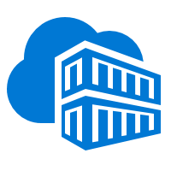


Integrated end-to-end Kubernetes experience
AKS production cluster
Web tier
Inner loop
Azure Container Registry
Source code control
Azure Monitor
Azure DevSpaces
AKS dev cluster
Test
Debug
Business tier
Auto-build
Azure Pipelines/ DevOps Project
Helm chart
Database tier
CI/CD

Slide 21

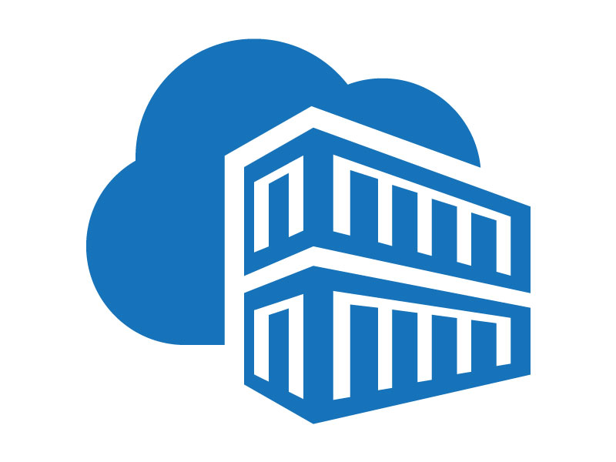
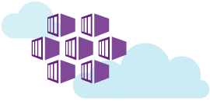
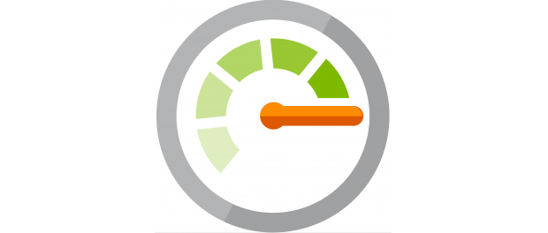
CI/CD Pipeline | Azure DevOps and AKS
Container-based CI/CD with Azure DevOps
Web App (Front End)
ASP.NET Core
Azure Container Registry
Web API (Restful Api)
ASP.NET Core
Load Balancer
AKS – Azure Kubernetes Service
Consumer
Azure Monitor for Containers
Development
Notes:
Overview of the CI/CD pipeline we will be building using Azure DevOps

Slide 22
Demonstration: Azure Container Registry
Azure Container Registry Walkthrough
Notes:
Please refer to Module 6 – Demos document section Demo 2 for detail instructions about the demo.

Slide 23
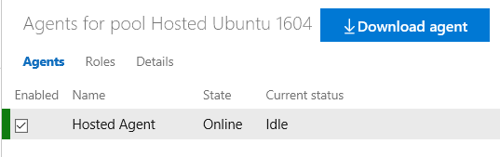
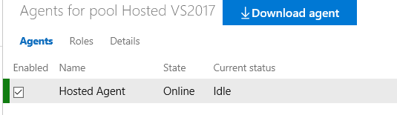
Azure DevOps Agents
Agents: To build your code or deploy your software you need at least one agent.
Private Agents : More control to install dependent software needed for builds and deployments
Hosted Agents: Microsoft provides the agent and takes care of the maintenance and upgrades
Linux Agents (Azure Pipeline / TFS 2017): https://docs.microsoft.com/en-us/azure/devops/pipelines/agents/v2-linux?view=vsts
Windows Agents (Azure Pipeline / TFS 2017): https://docs.microsoft.com/en-us/azure/devops/pipelines/agents/v2-windows
Notes:
Agents are needed to build, deploy and test your code.
Private Agents: You control/manage them
Hosted Agent: Managed/Controlled by Microsoft
Amongst hosted agents, your have Linux and Windows hosted agents.
Recommendation: Use Hosted unless you cannot
Note: vsts-agent image

Slide 24
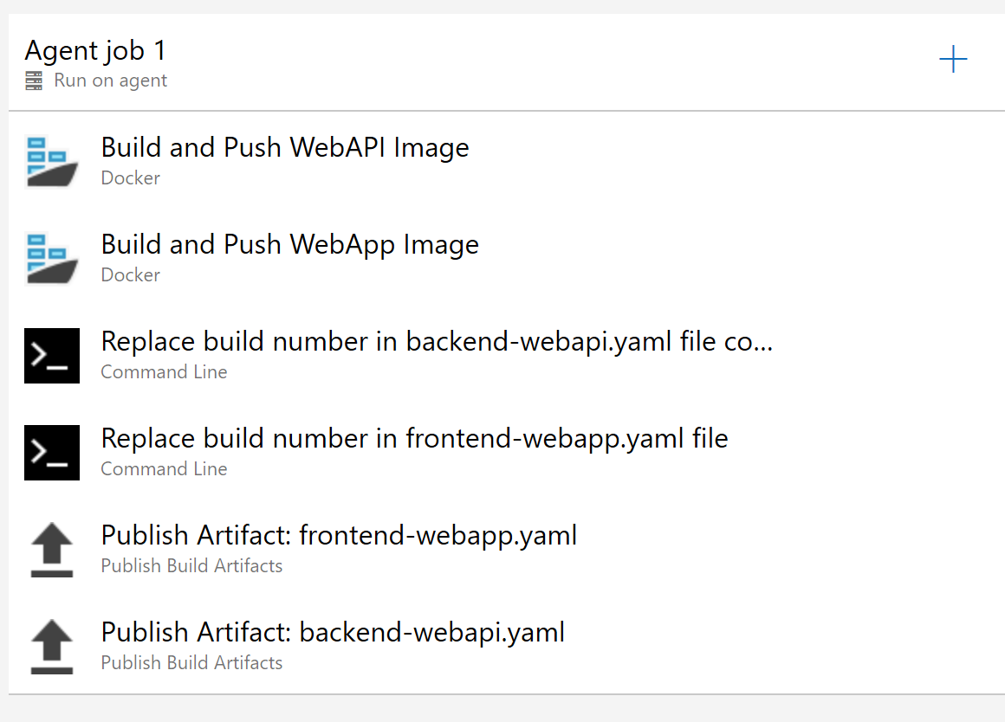
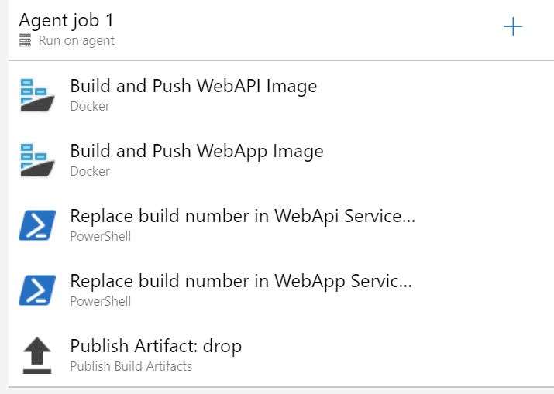
Build Pipeline
Build for Multi-Container ASP.NET Core Application using Linux Containers
Build for Multi-Container ASP.NET Core Application using Windows Containers

Slide 25
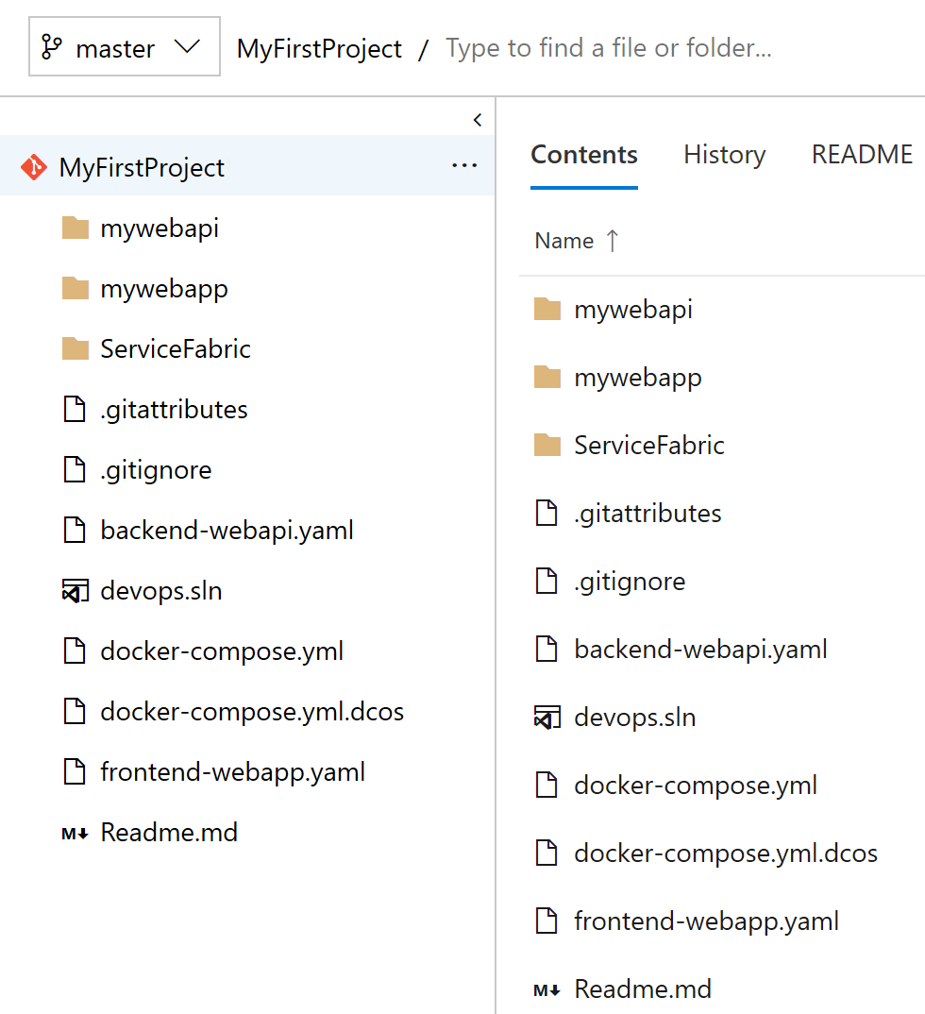
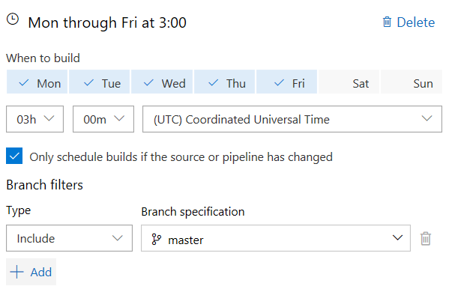
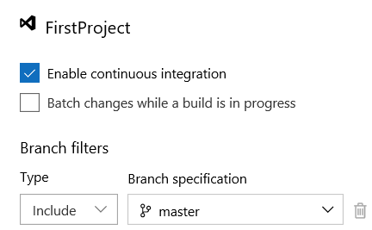
Continuous Integration Setting
Schedule Build
Example: Nightly/Daily
Build → Triggers → CI Enabled
Changes to a branch can trigger the build automatically
Notes:
Left hand side:
Code repository
Branch selected => master
Center:
Change to branch triggers build
Right:
Build can be scheduled on week days at certain hour.
It can also be triggered on-demand.

Slide 26
Demonstration: Build Pipeline
Build Pipeline for Multi-Container Application
Notes:
Please refer to Module 6 – Demos document section Demo 3 for detail instructions about the demo.

Slide 27
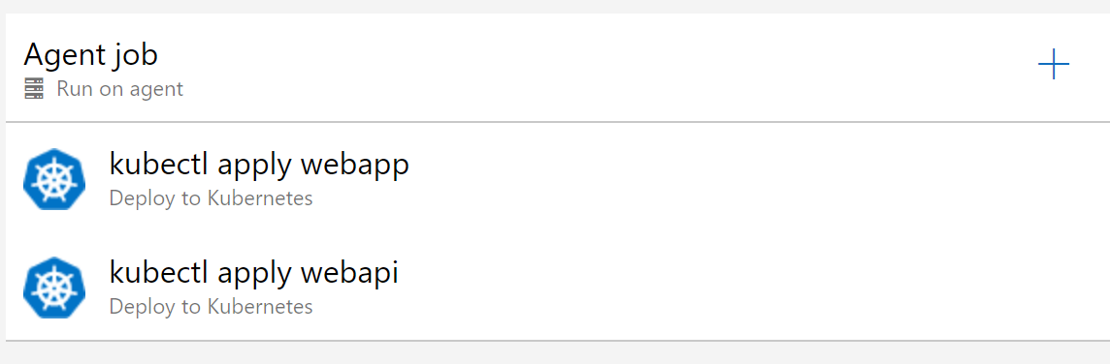
Release Pipeline
Release pipeline for AKS | Kubernetes
Notes:
Release pipeline => deploy what has been built
Left:
Kubernetes cluster in AKS => built-in kubectl task kubectl apply yaml files ⬄ what we did in previous lab in command line
Right:
- Docker Swarm cluster in ACS => command line script to be run remotely on Swarm master ⬄ previous lab.

Slide 28
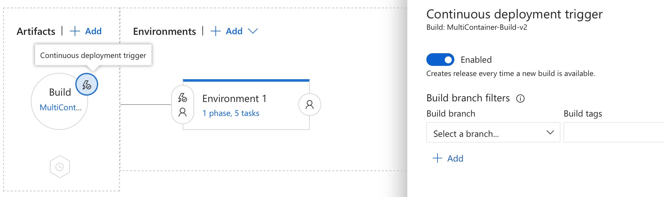
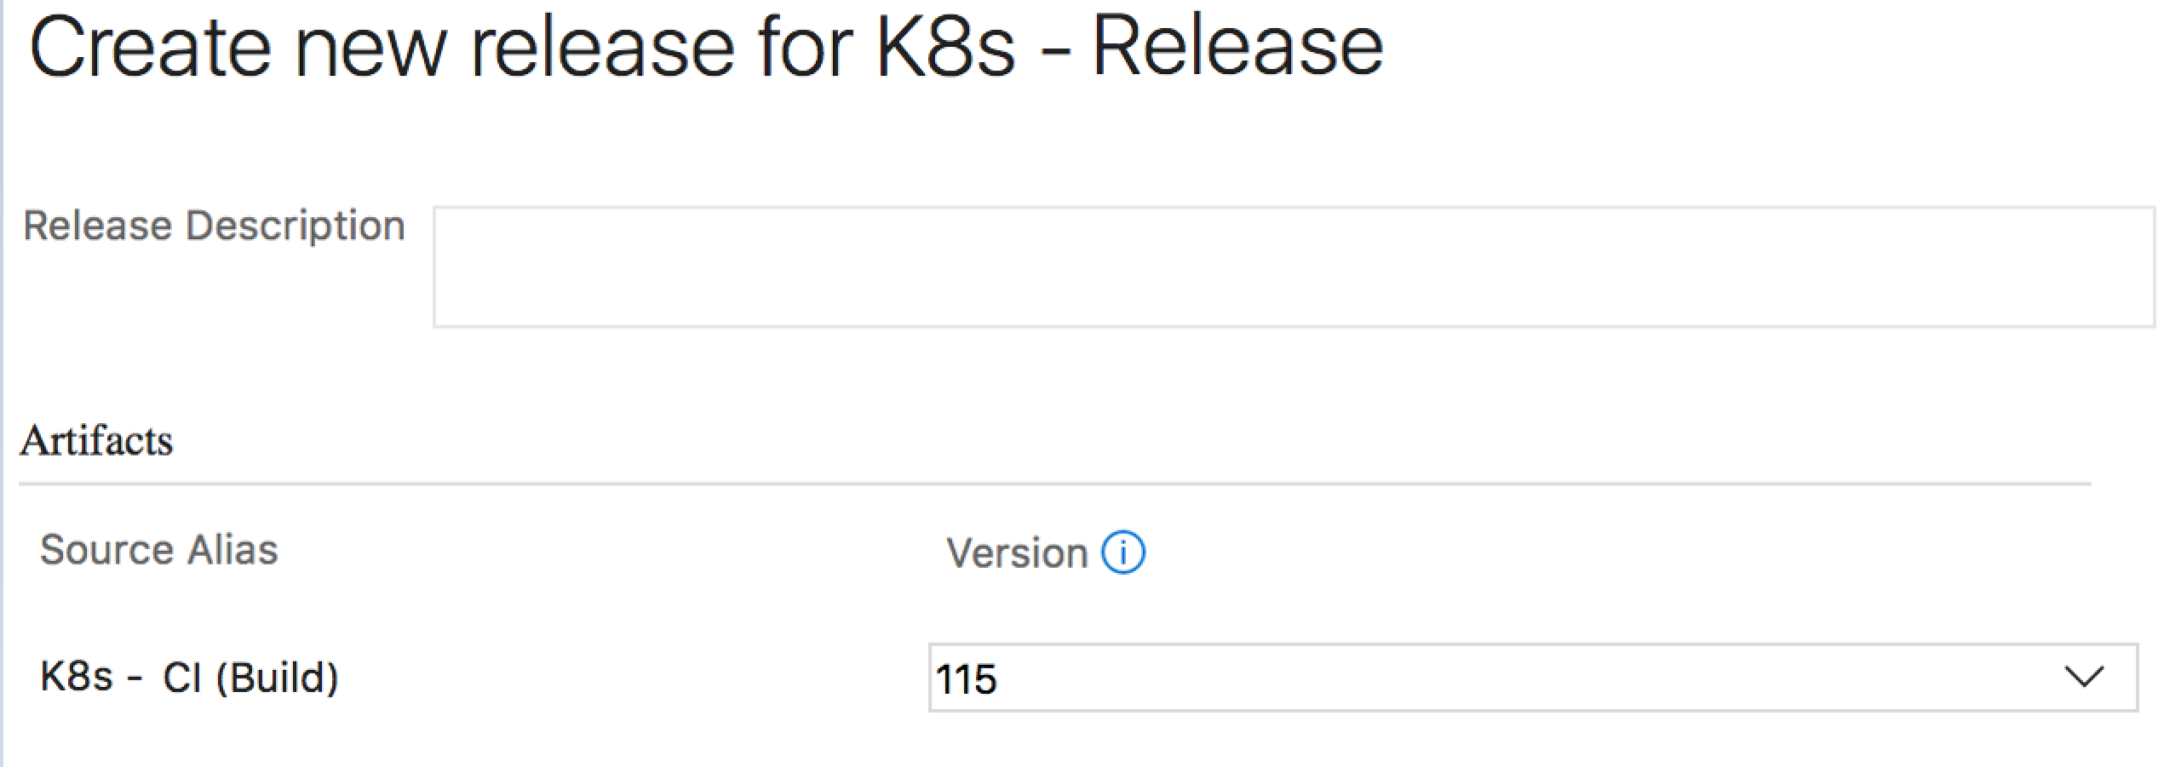
Azure Pipeline Continuous Deployment Setting
On-Demand Release Kickoff
Assign Build and select continuous deployment trigger
Continuous Deployment on every successful Build
Notes:
To trigger continuous deployment:
After a given build
Scheduled
On-demand => validation can be enforced (just like Code Review)

Slide 29
Demonstration: Release Pipeline
Release Pipeline for AKS
Continuous Deployment Setting
Notes:
Please refer to Module 6 – Demos document section Demo 4 for detail instructions about the demo.

Slide 30
Azure DevOps Project
If you would like to present the Azure DevOps Project section, use the following documentation to understand the service and set up the demo:
https://docs.microsoft.com/en-us/azure/devops-project/overview
https://docs.microsoft.com/en-us/azure/devops-project/azure-devops-project-aks?toc=https%3A%2F%2Fdocs.microsoft.com%2Fen-us%2Fazure%2Fdevops-project%2Ftoc.json&bc=https%3A%2F%2Fdocs.microsoft.com%2Fen-us%2Fazure%2Fbread%2Ftoc.json

Slide 31

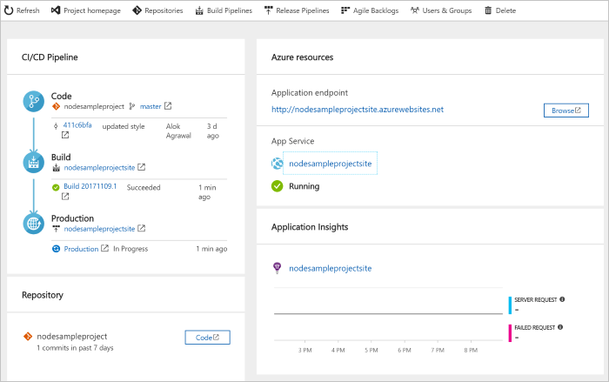
DevOps Pipelines in Minutes
Azure DevOps Projects
Create a full DevOps pipeline with 3 easy steps from the Azure Portal
Start with a Git repo and any source language
Web apps, Kubernetes and more
Customize, extend and scale when needed.
Notes:
Moving from the developer environment, Azure also makes deploying, or integrating existing, DevOps pipelines as fast as possible
Azure DevOps Projects is the quickest way to get started with DevOps on Azure for people who know about DevOps but are just starting or want a quick way to create a basic pipeline to play with or build upon.
DevOps projects creates a basic, complete CI/CD pipeline in Azure which can later be extended and customized outside in Azure Pipelines
Although DevOps Projects builds a DevOps pipeline on Azure it allows for any easy “Getting started” experience with Azure Pipelines which can then be applied to hybrid and on-prem scenarios with Azure Pipelines which can target any platform or with Azure DevOps Server which can be installed on prem.

Slide 32
Demonstration: Azure DevOps Project
Create an Azure DevOps Project for deploying to AKS

Slide 33
Recent updates
If possible, try cover some of the latest updates with your customers. Check out the below links for updates directly related to Kubernetes integration for Azure DevOps:
https://devblogs.microsoft.com/devops/announcing-kubernetes-integration-for-azure-pipelines/
https://docs.microsoft.com/en-us/azure/devops/release-notes/2019/build-may

Slide 35
Other CI/CD Walkthroughs in Jenkins
CI/CD with deployment in AKS
https://docs.microsoft.com/en-us/azure/aks/jenkins-continuous-deployment
CI/CD with deployment in Service Fabric (Linux)
https://docs.microsoft.com/en-us/azure/service-fabric/service-fabric-cicd-your-linux-applications-with-jenkins
Notes:
Other resources to walk you through:
Deploying in AKS from Jenkins
Deploying in Service Fabric Linux cluster from Jenkins

Slide 36
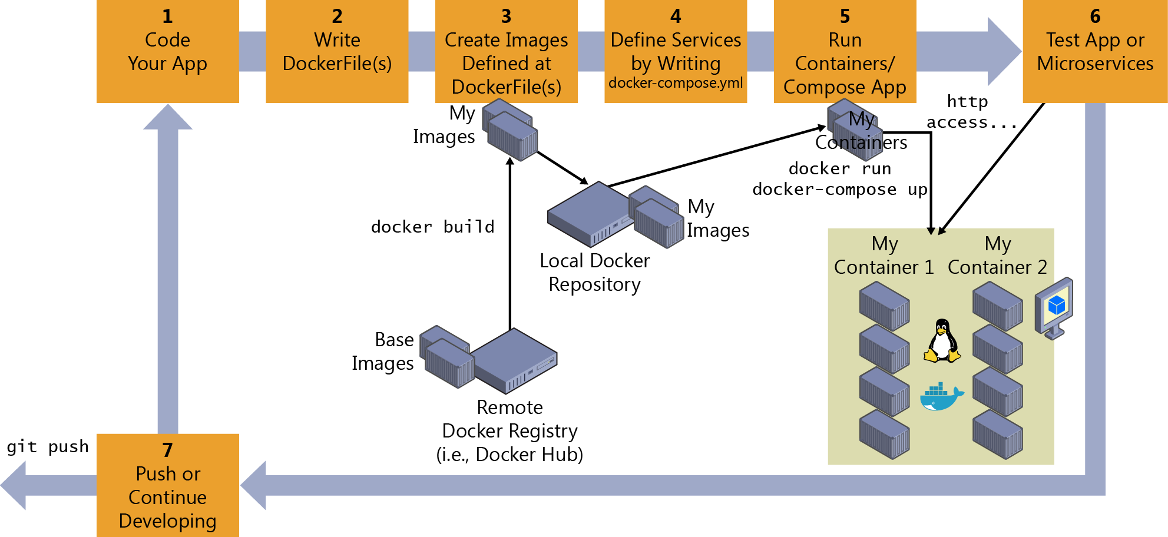
Inner-Loop Development
Notes:
It all begins on each developer's machine, coding the app itself, using their preferred languages or platforms, and testing it locally
But in every case, you will have a very important point in common, no matter what language, framework, or platforms you choose.
In this specific workflow, you are always developing and testing Docker containers locally
Docker image instance/container will container: An OS (Linux distro/Windows), Files added by the dev (ex. App binaries), Config (ex. Environment settings/dependenices), Instructions for what processes to run by Docker
You can work with Docker CLI and write your code using any code editor, but if you use Visual Studio Code, it makes it easy to author Dockerfile and docker-compose.yml files in your workspace. Plus, you can run Visual Studio Code tasks from the IDE that will prompt scripts that can be running elaborated operations using Docker CLI underneath.
The DockerFile is usually placed within the root folder of your app or service and contains the required commands so that Docker knows how to set up and run that app or service. You can create your DockerFile and add it to your project along with your code (node.js, .NET Core, etc.), or, if you are new to the environment, take a look at the following Tip. (one per custom image) You can create a custom image leveraging existing, or from scratch in Linux (not recommended when you are just starting out)
Create images from your dockerfile specs (When taking into account the "outer-loop DevOps workflow," the images will be created by an automated build process whenever you push your source code to a Git repository (Continuous Integration) so the images will be created in that global environment from your source code.) But, before we consider going to that outer-loop route, we need to ensure that the Docker application is actually working properly so that they don't push code that might not work properly to the source control system (Git, etc.). Therefore, each developer first needs to do the entire inner-loop process to test locally and continue developing until they want to push a complete feature or change to the source control system.
Step 4: (Optional) Define your services in docker-compose.yml when building a composed Docker app with multiple services. With the docker-compose.yml file you can define a set of related services to be deployed as a composed application with the deployment commands explained in the next step section (create that file in your main or root solution folder)
Step 5: Build and run your Docker app: If your app has only a single container, you just need to run it by deploying it to your Docker Host (VM or physical server). However, if your app is made up of multiple services, you need to compose it, too. Let's see the different options. Note docker-compose up and docker run might be enough for testing your containers in your development environment, but you might not use them at all if you are expecting to work with Docker clusters and orchestrators like Docker Swarm, Mesosphere DC/OS, or Kubernetes in order to be able to scale up
Test locally: Visual Studio Code supports debugging Docker if you're using Node.js and other platforms like .NET Core containers. You also can debug .NET Core containers in Docker when using Visual Studio, as described in the next section.

Slide 37
Additional resources
https://cloudblogs.microsoft.com/opensource/2018/11/27/tutorial-azure-devops-setup-cicd-pipeline-kubernetes-docker-helm/

